Slide 1


MLOps: Deployment, Monitoring and Reliability
27
PART V · DATA SCIENCE IN SYSTEMS CONTEXT
CHAPTER 27 · WEEK 16
Data Science — From Foundations to Intelligent Systems
LECTURER
Dr. Mustafa Hameed
THE ISLAMIA UNIVERSITY OF BAHAWALPUR
Bahawalpur, Pakistan
Department of Information Technology · BSIT · Fall 2026
Notes:
Chapter 27: MLOps: Deployment, Monitoring and Reliability. Part 5 — Data Science in Systems Context. Week 16: MLOps; ethics; practice & capstone. Handout pages 175–182.

Slide 2

Where this chapter sits
THE COURSE
PART I
PART II
PART III
PART IV
PART V
PART VI
1
2
3
4
5
6
7
8
9
10
11
12
13
14
15
16
17
18
19
20
21
22
23
24
25
26
27
28
29
30
31
32
MLOps: Deployment, Monitoring and Reliability
BUILDS ON
USED LATER IN
Ch 14 Model Evaluation and Selection
Ch 30 Managing Data Science Projects
Ch 19 Sequences, Time Series and Streaming Analytics
Ch 24 Cloud and Edge Computing for Data Science
Data Science · Chapter 27 · MLOps: Deployment, Monitoring and Reliability
Handout p. 175 2
Notes:
Place the chapter. Before you start: Chapter 24 (containers and deployment tiers), Chapter 19 (drift) and Chapter 14 (the metrics you will monitor).

Slide 3

What you will be able to do
LEARNING OUTCOMES
By the end of this chapter you will be able to:
1
Describe the path from a trained model to a monitored production service.
2
Choose between batch, online and edge serving for a stated requirement.
3
Specify what to version so that a prediction can be reproduced months later.
4
Design a monitoring plan covering data, prediction and outcome drift.
5
Plan a safe rollout and rollback.
Data Science · Chapter 27 · MLOps: Deployment, Monitoring and Reliability
Handout p. 175 3
Notes:
Read these out: they are the chapter's contract with the room. Each click adds one.

Slide 4

Vocabulary for this chapter
KEY TERMS
MLOps
model registry
feature store
training–serving skew
batch / online / edge inference
CI/CD
shadow deployment
canary release
A/B test
rollback
data drift
prediction drift
ground-truth lag
observability
model card
Each term is defined where it first matters — not here.
Data Science · Chapter 27 · MLOps: Deployment, Monitoring and Reliability
Handout p. 175 4
Notes:
Do not define these now; they arrive one at a time. This slide is for the students' notes. Terms: MLOps; model registry; feature store; training–serving skew; batch / online / edge inference; CI/CD; shadow deployment; canary release; A/B test; rollback; data drift; prediction drift; ground-truth lag; observability; model card.

Slide 5

In this chapter
IN THIS CHAPTER
27.1
The Gap Between a Notebook and a System
p. 175 ›
27.2
Serving Patterns
p. 176 ›
27.3
Training–Serving Skew
p. 176 ›
27.4
What to Version
p. 176 ›
27.5
Monitoring
p. 177 ›
27.6
Safe Rollout
p. 177 ›
Data Science · Chapter 27 · MLOps: Deployment, Monitoring and Reliability
Handout pp. 175–182 5
Notes:
The route through the chapter. Each row is a link: click it to jump to that section in the slide show.

Slide 6
The Gap Between a Notebook and a System
SECTION 1 OF 6
27.1
27.1 The Gap Between a Notebook and a System
27.2 Serving Patterns
27.3 Training–Serving Skew
27.4 What to Version
27.5 Monitoring
27.6 Safe Rollout
Data Science · Chapter 27
Handout §27.1 6
Notes:
Pause. Name the question this section answers.

Slide 7

What Changes at Deployment
CONCEPT
A notebook model runs once, on data you chose, with you watching. A deployed model runs thousands of times a day, on data nobody inspected, with nobody watching, for years — while the world it was trained on changes. MLOps is the engineering discipline that makes the second situation survivable.
Data Science · Chapter 27 · MLOps: Deployment, Monitoring and Reliability
§27.1 · Handout p. 175 7
Notes:
Read the box aloud, then ask for an example from the room before moving on.

Slide 8
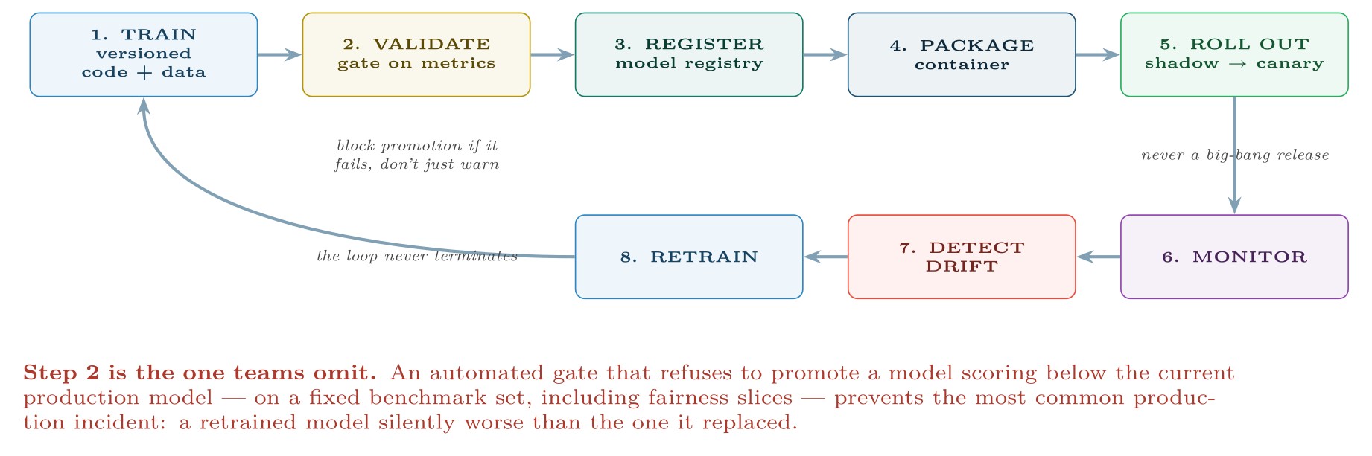
The MLOps lifecycle
FIGURE 27.1
It is a closed loop, and the arrow from retraining back to training is the one that distinguishes a maintained system from an abandoned one.
Data Science · Chapter 27 · MLOps: Deployment, Monitoring and Reliability
§27.1 · Handout p. 175 8
Notes:
Figure 27.1 (handout p. 175): The MLOps lifecycle. It is a closed loop, and the arrow from retraining back to training is the one that distinguishes a maintained system from an abandoned one.

Slide 9
Serving Patterns
SECTION 2 OF 6
27.2
27.1 The Gap Between a Notebook and a System
27.2 Serving Patterns
27.3 Training–Serving Skew
27.4 What to Version
27.5 Monitoring
27.6 Safe Rollout
Data Science · Chapter 27
Handout §27.2 9
Notes:
Pause. Name the question this section answers.

Slide 10

Serving Patterns
AT A GLANCE
 | Batch | Online (API) | Edge
When it runs | On a schedule | On request | On the device, continuously
Latency | Hours | 10–500 ms | <10 ms
Complexity | Lowest | Moderate | Highest — updates are hard
Good for | Weekly risk scores, nightly maintenance lists | Fraud checks, live recommendations | Safety shutdowns, offline operation
Watch out for | Staleness — the score is as old as the last run | Latency budget, autoscaling, cold starts | Model size, power, over-the-air updates
Data Science · Chapter 27 · MLOps: Deployment, Monitoring and Reliability
§27.2 · Handout p. 176 10
Notes:
Do not read the table row by row: pick the row the room is most likely to get wrong and ask why.

Slide 11
Choose the Simplest That Meets the Requirement
CONCEPT
Most student projects reach for an API when a nightly batch job would serve the decision perfectly well. If the intervention happens on Monday mornings, a Sunday night batch is simpler, cheaper, easier to monitor and easier to reproduce. Real-time serving is a cost you should incur only when the decision genuinely cannot wait.
Data Science · Chapter 27 · MLOps: Deployment, Monitoring and Reliability
§27.2 · Handout p. 176 11
Notes:
Read the box aloud, then ask for an example from the room before moving on.

Slide 12

The Most Common Production Failure
WATCH OUT
The model was trained on features computed by a pandas script, and serves on features computed by a Java service written by a different team. The two implementations disagree slightly — a different null handling, a different timezone, a rounding difference — and accuracy in production is far below what testing promised. Nothing is broken and no error is raised.
The fix: compute features in one place. A feature store serves the same computed features to both training and inference, which eliminates the class of bug entirely rather than testing for it.
Data Science · Chapter 27 · MLOps: Deployment, Monitoring and Reliability
§27.3 · Handout p. 176 12
Notes:
Read the box aloud, then ask for an example from the room before moving on.

Slide 13
What to Version
SECTION 4 OF 6
27.4
27.1 The Gap Between a Notebook and a System
27.2 Serving Patterns
27.3 Training–Serving Skew
27.4 What to Version
27.5 Monitoring
27.6 Safe Rollout
Data Science · Chapter 27
Handout §27.4 13
Notes:
Pause. Name the question this section answers.

Slide 14

Reproducibility Requires Five Things
DEFINITION
To reproduce a prediction made eight months ago you need: the code, the data (or a snapshot reference), the environment (container image), the hyperparameters, and the model artefact itself — each tied together by a single run identifier. Missing any one makes the result unreproducible, and an unreproducible result cannot be defended when challenged.
Data Science · Chapter 27 · MLOps: Deployment, Monitoring and Reliability
§27.4 · Handout p. 176 14
Notes:
Read the box aloud, then ask for an example from the room before moving on.

Slide 15
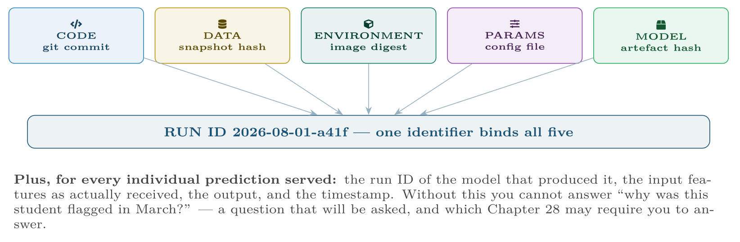
The five things that must be versioned together
FIGURE 27.2
A model registry exists to keep these bound to one identifier, so that any past prediction can be explained and reproduced.
Data Science · Chapter 27 · MLOps: Deployment, Monitoring and Reliability
§27.4 · Handout p. 176 15
Notes:
Figure 27.2 (handout p. 177): The five things that must be versioned together. A model registry exists to keep these bound to one identifier, so that any past prediction can be explained and reproduced.

Slide 16
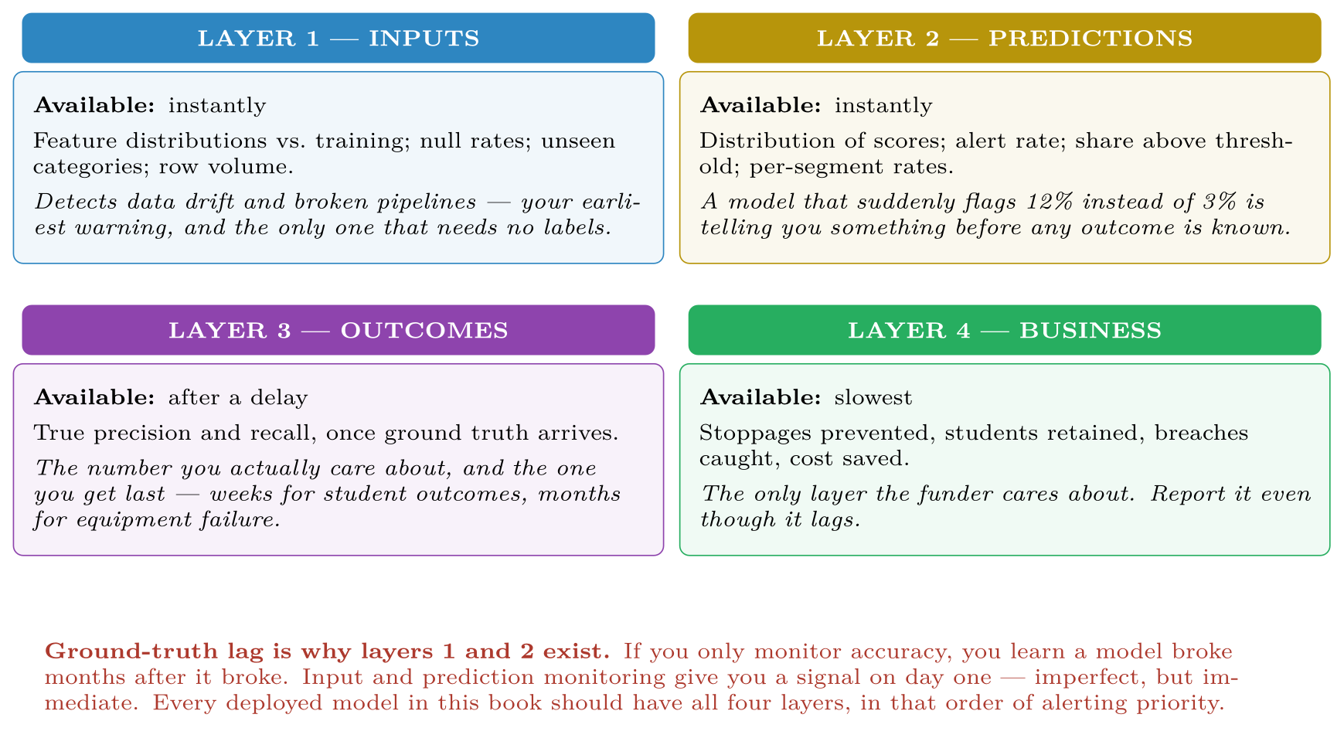
Four monitoring layers, ordered by how quickly each becomes available
FIGURE 27.3
Alert on layers 1 and 2; report layers 3 and 4.
Data Science · Chapter 27 · MLOps: Deployment, Monitoring and Reliability
§27.5 · Handout p. 177 16
Notes:
Figure 27.3 (handout p. 177): Four monitoring layers, ordered by how quickly each becomes available. Alert on layers 1 and 2; report layers 3 and 4.

Slide 17
Safe Rollout
SECTION 6 OF 6
27.6
27.1 The Gap Between a Notebook and a System
27.2 Serving Patterns
27.3 Training–Serving Skew
27.4 What to Version
27.5 Monitoring
27.6 Safe Rollout
Data Science · Chapter 27
Handout §27.6 17
Notes:
Pause. Name the question this section answers.

Slide 18
Shadow, Canary, and Rollback
DEFINITION
Shadow: the new model runs on live traffic and its predictions are logged but not acted on — zero risk, real data. Canary: it serves a small percentage of real traffic, with automatic rollback if metrics degrade. Rollback: reverting to the previous version, which must be a single command and must be rehearsed.
Data Science · Chapter 27 · MLOps: Deployment, Monitoring and Reliability
§27.6 · Handout p. 177 18
Notes:
Read the box aloud, then ask for an example from the room before moving on.

Slide 19

Rolling Out a New Model Safely
WORKED EXAMPLE
The dropout model is retrained and scores better offline. How does it reach production?
Week 1 — shadow. Both models score every student; only the old model’s output drives outreach. Compare on live data: do they agree? Where they disagree, which is right? This catches training–serving skew, which offline testing cannot.
Week 2 — canary at 10%. A random 10% of students are scored by the new model. Automatic rollback triggers if the alert rate moves more than 50% from baseline, or if any monitored fairness slice degrades.
Week 3 — 50%, then 100%. Advance only if layer-1 and layer-2 monitors are stable.
Week 8 — outcome evaluation. The first real precision figures arrive as term results come in. Only now do you actually know whether the new model was better.
Keep the old model deployable for a full outcome cycle. Offline metrics promised an improvement; only week 8 confirms it, and until then rollback must remain one command away.
Data Science · Chapter 27 · MLOps: Deployment, Monitoring and Reliability
§27.6 · Handout p. 177 19
Notes:
Each click adds one step of the working. Ask for the next number before you reveal it.

Slide 20





Four lenses: Operating Models in Production
FOUR LENSES
LEARNING ANALYTICS
PROJECT MANAGEMENT
Serving: weekly batch — outreach happens on a schedule, so an API is unnecessary complexity.
Serving: batch, weekly.
INTERNET OF THINGS
CYBERSECURITY
Serving: edge, which makes deployment the hard part — over-the-air updates across a fleet on unreliable links, with staged rollout by device group and automatic rollback if a device fails to check in.
Serving: online and streaming — detection latency is a control.
Data Science · Chapter 27 · MLOps: Deployment, Monitoring and Reliability
Handout p. 182 20
Notes:
The same method, four domains. Each of the next four slides opens one lens in full.

Slide 21

Learning Analytics: Operating Models in Production
FOUR LENSES
LEARNING ANALYTICS
Project Management
Serving: weekly batch — outreach happens on a schedule, so an API is unnecessary complexity. Ground-truth lag: an entire term, which is why input and prediction monitoring carry the alerting load. Special requirement: every prediction must be logged with its features and model version, because a student may ask why they were contacted and the institution must be able to answer (Chapter 28). Retraining: annually, per cohort — retraining mid-term changes the rules on students partway through.
Internet of Things
Cybersecurity
Data Science · Chapter 27 · MLOps: Deployment, Monitoring and Reliability
Handout p. 182 21
Notes:
Learning Analytics. Serving: weekly batch — outreach happens on a schedule, so an API is unnecessary complexity. Ground-truth lag: an entire term, which is why input and prediction monitoring carry the alerting load. Special requirement: every prediction must be logged with its features and model version, because a student may ask why they were contacted and the institution must be able to answer (Chapter 28). Retraining: annually, per cohort — retraining mid-term changes the rules on students partway through.

Slide 22

Project Management: Operating Models in Production
FOUR LENSES
PROJECT MANAGEMENT
Learning Analytics
Serving: batch, weekly. Special difficulty: the prediction changes the outcome — a team told it will miss the sprint often does not, which makes the model look wrong precisely when it worked. Log the prediction and whether it was shown, so this can be analysed rather than argued about. Retraining: whenever team composition changes materially, not on a calendar.
Internet of Things
Cybersecurity
Data Science · Chapter 27 · MLOps: Deployment, Monitoring and Reliability
Handout p. 182 22
Notes:
Project Management. Serving: batch, weekly. Special difficulty: the prediction changes the outcome — a team told it will miss the sprint often does not, which makes the model look wrong precisely when it worked. Log the prediction and whether it was shown, so this can be analysed rather than argued about. Retraining: whenever team composition changes materially, not on a calendar.

Slide 23

Internet of Things: Operating Models in Production
FOUR LENSES
INTERNET OF THINGS
Learning Analytics
Serving: edge, which makes deployment the hard part — over-the-air updates across a fleet on unreliable links, with staged rollout by device group and automatic rollback if a device fails to check in. Monitoring: you must watch the devices as well as the model, and distinguish model drift from sensor drift (Chapter 25). Retraining: monthly in the cloud on accumulated features, pushed down after canary on a device subset.
Project Management
Cybersecurity
Data Science · Chapter 27 · MLOps: Deployment, Monitoring and Reliability
Handout p. 182 23
Notes:
Internet of Things. Serving: edge, which makes deployment the hard part — over-the-air updates across a fleet on unreliable links, with staged rollout by device group and automatic rollback if a device fails to check in. Monitoring: you must watch the devices as well as the model, and distinguish model drift from sensor drift (Chapter 25). Retraining: monthly in the cloud on accumulated features, pushed down after canary on a device subset.

Slide 24

Cybersecurity: Operating Models in Production
FOUR LENSES
CYBERSECURITY
Learning Analytics
Serving: online and streaming — detection latency is a control. Retraining: frequent, because the adversary adapts — but each retrain is an attack surface (Chapter 26), so the training set must be screened and promotion gated by a human. Monitoring: alerts per analyst per hour is a first-class operational metric, and a sharp drop in alert volume is as alarming as a spike, since it may mean a log source has silently died.
Project Management
Internet of Things
Data Science · Chapter 27 · MLOps: Deployment, Monitoring and Reliability
Handout p. 182 24
Notes:
Cybersecurity. Serving: online and streaming — detection latency is a control. Retraining: frequent, because the adversary adapts — but each retrain is an attack surface (Chapter 26), so the training set must be screened and promotion gated by a human. Monitoring: alerts per analyst per hour is a first-class operational metric, and a sharp drop in alert volume is as alarming as a spike, since it may mean a log source has silently died.

Slide 25

Try it yourself: A Monitored Service
TRY IT YOURSELF
WHAT YOU WILL DO
1. LAYER 1: input drift, available immediately
2. LAYER 2: prediction drift
3. Every prediction is logged so it can be explained later
4. The promotion gate: refuse to ship a worse model
THIS WEEK'S LAB
WHAT YOU WILL RUN
Week 16: Monitored service; fairness measurement
1 listing, 51 lines of Python
Data Science · Chapter 27 · MLOps: Deployment, Monitoring and Reliability
§27.6 · Handout p. 177 25
Notes:
Say what the room will have at the end of the lab, then let them start. Circulate rather than lecture.

Slide 26
A Monitored Service
LAB · STEP 1 OF 5
Set-up
Python
1
2
3
4
5
6
import json, hashlib, numpy as np, pandas as pd
from datetime import datetime
from scipy.stats import ks_2samp
MODEL_VERSION = "2026.08.1"
TRAINING_REF = pd.read_parquet("reference_features.parquet") # training snapshot
Data Science · Chapter 27 · MLOps: Deployment, Monitoring and Reliability
§27.6 · Handout p. 177 26
Notes:
Step 1: Set-up. Read the code aloud; ask what each line would print before running it.

Slide 27
A Monitored Service
LAB · STEP 2 OF 5
LAYER 1: input drift, available immediately
Python
7
8
9
10
11
12
13
14
15
16
17
18
# --- LAYER 1: input drift, available immediately -----------------------
def input_drift(live: pd.DataFrame, ref=TRAINING_REF, alpha=0.01):
"""KS test per feature. Note: with large n everything is 'significant'
(Chapter 9), so gate on the STATISTIC, not the p-value."""
report = {}
for col in ref.columns:
stat, _ = ks_2samp(ref[col].dropna(), live[col].dropna())
report[col] = {"ks": round(float(stat), 4), "drifted": stat > 0.15}
unseen = set(live.get("programme", [])) - set(ref.get("programme", []))
report["_unseen_categories"] = list(unseen)
report["_null_rates"] = live.isna().mean().round(3).to_dict()
return report
Data Science · Chapter 27 · MLOps: Deployment, Monitoring and Reliability
§27.6 · Handout p. 177 27
Notes:
Step 2: LAYER 1: input drift, available immediately. Read the code aloud; ask what each line would print before running it.

Slide 28
A Monitored Service
LAB · STEP 3 OF 5
LAYER 2: prediction drift
Python
19
20
21
22
23
24
# --- LAYER 2: prediction drift -----------------------------------------
def prediction_drift(scores, baseline_rate, threshold, tol=0.5):
rate = float((scores > threshold).mean())
return {"alert_rate": round(rate, 4),
"baseline": baseline_rate,
"drifted": abs(rate - baseline_rate) > tol * baseline_rate}
Data Science · Chapter 27 · MLOps: Deployment, Monitoring and Reliability
§27.6 · Handout p. 177 28
Notes:
Step 3: LAYER 2: prediction drift. Read the code aloud; ask what each line would print before running it.

Slide 29
A Monitored Service
LAB · STEP 4 OF 5
Every prediction is logged so it can be explained later
Python
25
26
27
28
29
30
31
32
33
34
35
36
37
38
39
# --- every prediction is logged so it can be explained later ----------
def serve(features: pd.DataFrame):
scores = model.predict_proba(features)[:, 1]
for i, row in features.iterrows():
log_prediction({
"run_id": MODEL_VERSION,
"entity_id": row["student_id"],
"features": row.drop("student_id").to_dict(), # as RECEIVED
"feature_hash": hashlib.sha256(
json.dumps(row.to_dict(), sort_keys=True,
default=str).encode()).hexdigest()[:12],
"score": float(scores[i]),
"ts": datetime.utcnow().isoformat(),
})
return scores
Data Science · Chapter 27 · MLOps: Deployment, Monitoring and Reliability
§27.6 · Handout p. 177 29
Notes:
Step 4: Every prediction is logged so it can be explained later. Read the code aloud; ask what each line would print before running it.

Slide 30
A Monitored Service
LAB · STEP 5 OF 5
The promotion gate: refuse to ship a worse model
Python
40
41
42
43
44
45
46
47
# --- the promotion gate: refuse to ship a worse model -----------------
def promotion_gate(new_metrics, prod_metrics, slices):
if new_metrics["pr_auc"] < prod_metrics["pr_auc"]:
raise RuntimeError("BLOCKED: new model is worse on the benchmark set")
for s in slices: # fairness slices, Chapter 28
if new_metrics[s]["recall"] < prod_metrics[s]["recall"] - 0.05:
raise RuntimeError(f"BLOCKED: recall regressed on slice '{s}'")
return True
Data Science · Chapter 27 · MLOps: Deployment, Monitoring and Reliability
§27.6 · Handout p. 177 30
Notes:
Step 5: The promotion gate: refuse to ship a worse model. Read the code aloud; ask what each line would print before running it.

Slide 31

Define training–serving skew and give a concrete example. What eliminates the whole class of bug?
CHECKPOINT 1 OF 3
Discuss with the person next to you, then advance.
Data Science · Chapter 27 · MLOps: Deployment, Monitoring and Reliability
Handout p. 182 · answers in Appendix D 31
Notes:
Ask the room. Do not advance until someone commits to an answer.

Slide 32

Define training–serving skew and give a concrete example. What eliminates the whole class of bug?
CHECKPOINT 1 OF 3 · ANSWER
Training and serving compute features with different code, so they disagree subtly — for example a different timezone or null convention. Example: training uses fillna(median) and serving uses fillna(0). A feature store eliminates the class of bug by computing features once for both paths.
Data Science · Chapter 27 · MLOps: Deployment, Monitoring and Reliability
Handout p. 182 · answers in Appendix D 32
Notes:
Answer (Appendix D): Training and serving compute features with different code, so they disagree subtly — for example a different timezone or null convention. Example: training uses fillna(median) and serving uses fillna(0). A feature store eliminates the class of bug by computing features once for both paths.

Slide 33
Your outcome labels arrive three months late. Which monitoring layers give you a same-day signal, and what can each actually detect?
CHECKPOINT 2 OF 3
Discuss with the person next to you, then advance.
Data Science · Chapter 27 · MLOps: Deployment, Monitoring and Reliability
Handout p. 182 · answers in Appendix D 33
Notes:
Ask the room. Do not advance until someone commits to an answer.

Slide 34
Your outcome labels arrive three months late. Which monitoring layers give you a same-day signal, and what can each actually detect?
CHECKPOINT 2 OF 3 · ANSWER
Layers 1 and 2 — input distributions and prediction distributions. Layer 1 detects broken pipelines, changed upstream schemas and data drift; layer 2 detects a model whose behaviour has shifted, e.g. flagging 12% where it used to flag 3%.
Data Science · Chapter 27 · MLOps: Deployment, Monitoring and Reliability
Handout p. 182 · answers in Appendix D 34
Notes:
Answer (Appendix D): Layers 1 and 2 — input distributions and prediction distributions. Layer 1 detects broken pipelines, changed upstream schemas and data drift; layer 2 detects a model whose behaviour has shifted, e.g. flagging 12% where it used to flag 3%.

Slide 35
A retrained model scores better offline. Why is that insufficient reason to replace the production model immediately?
CHECKPOINT 3 OF 3
Discuss with the person next to you, then advance.
Data Science · Chapter 27 · MLOps: Deployment, Monitoring and Reliability
Handout p. 182 · answers in Appendix D 35
Notes:
Ask the room. Do not advance until someone commits to an answer.

Slide 36
A retrained model scores better offline. Why is that insufficient reason to replace the production model immediately?
CHECKPOINT 3 OF 3 · ANSWER
Because offline metrics do not capture training–serving skew, latency, or the effect on real behaviour. Shadow and canary deployment test those on live traffic before the new model drives any decision.
Data Science · Chapter 27 · MLOps: Deployment, Monitoring and Reliability
Handout p. 182 · answers in Appendix D 36
Notes:
Answer (Appendix D): Because offline metrics do not capture training–serving skew, latency, or the effect on real behaviour. Shadow and canary deployment test those on live traffic before the new model drives any decision.

Slide 37

What to take away
CHAPTER SUMMARY
1
MLOps closes the loop: train, validate, register, package, roll out, monitor, detect drift, retrain.
2
An automated promotion gate that blocks a worse model prevents the most common production incident.
3
Choose the simplest serving pattern that meets the latency the decision genuinely needs.
4
Training–serving skew is eliminated by computing features in one place, not by testing harder.
5
Version code, data, environment, parameters and artefact under one run ID, and log every prediction with the version that made it.
6
Monitor inputs and predictions for an immediate signal; outcomes and business impact arrive later but are what matter.
7
Roll out via shadow then canary, keep rollback to one command, and keep the old model deployable for a full outcome cycle.
Data Science · Chapter 27 · MLOps: Deployment, Monitoring and Reliability
Handout p. 182 37
Notes:
Ask the room to say each takeaway before you reveal it.

Slide 38

Quick check 1 of 2
REVIEW · MULTIPLE CHOICE
Running a new model on live traffic without acting on its output is called:
A
canary
B
shadow
C
rollback
D
A/B testing
Data Science · Chapter 27 · MLOps: Deployment, Monitoring and Reliability
Handout p. 182 38
Notes:
Take a show of hands for each option before discussing. (The handout does not print MCQ answers.)

Slide 39
Quick check 2 of 2
REVIEW · MULTIPLE CHOICE
Which monitoring layer requires no ground truth?
A
outcome
B
business impact
C
input distribution
D
precision
Data Science · Chapter 27 · MLOps: Deployment, Monitoring and Reliability
Handout p. 182 39
Notes:
Take a show of hands for each option before discussing. (The handout does not print MCQ answers.)

Slide 40
For your notebook
REVIEW QUESTIONS
SHORT
List the five things that must be versioned to reproduce a prediction, and say what goes wrong if the environment is omitted.
SHORT
Explain ground-truth lag and its consequence for how you design alerting.
SHORT
Why can a sudden drop in alert volume be as serious as a spike?
APPLIED
Write the monitoring plan for the predictive maintenance model of Chapter 25: state what you measure at each of the four layers, the alert threshold for each, and who is paged.
APPLIED
Your team wants to auto-retrain and auto-deploy nightly. Give three arguments in favour, three risks, and the specific gates you would require before agreeing — noting where the security domain differs.
Data Science · Chapter 27 · MLOps: Deployment, Monitoring and Reliability
Handout p. 182 40
Notes:
Set these for independent study. Model answers are not printed in the handout.

Slide 41
End of Chapter 27
27
NEXT
READ
Chapter 28 — Responsible AI and Data Ethics
Handout Chapter 27, pages 175–182
THIS WEEK'S LAB
ASSESSMENT
Monitored service; fairness measurement
Capstone due
Data Science · Chapter 27 · MLOps: Deployment, Monitoring and Reliability
41
Notes:
Close. NEXT: Chapter 28 — Responsible AI and Data Ethics. READ: Handout Chapter 27, pages 175–182. THIS WEEK'S LAB: Monitored service; fairness measurement. ASSESSMENT: Capstone due.

